Slide 1
Capstone Project
TELECOM CHURN ANALYSIS
Team Members Ankit Sharma Mayur K. Choudhari Arun Aherkar Mahesh Patil Appasaheb Thorat

Slide 2
CONTENT
Introduction
Business Problem Identification
Project Objective
Data Description
Exploratory Data Analysis
Challenges
Conclusion
Recommendation

Slide 3
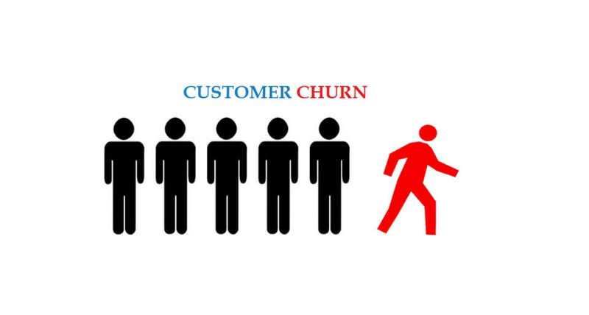
Introduction
The average churn rate in the telecom industry is approximately 1.9% per month, but could rise as high as 67% annually * as per survey conduct.
Churn is a problem for telecom Industries because it is more expensive to acquire a new customer than to keep your existing one from leaving.
Customer churn in the telecom industry poses one of the most significant risks to loss of revenue.
Churn Costumers are those targeted customer who have decided to leave a service Provider, product or even a company.

Slide 4
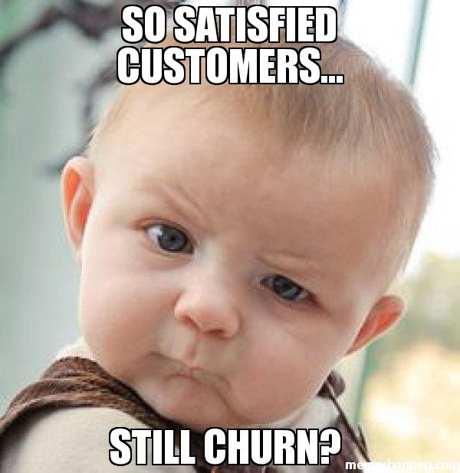
Business Problem Identification
This project aims to analyse the data to determine the cause of customer churn customers who are most likely subject to churn, and what to do to retain the most valuable customer.
To reduce customer churn, telecom companies need to predict which customers are at high risk of churn for this we taking advantage of the vast streams of rich telecom customer data.
For Telecom Churn Analysis, Problem can be defined as:
Customer Churn:
- In this we have to look into the problem why customers are leaving.
-for different state churn rate is different.
-looking for customer satisfaction.

Slide 5
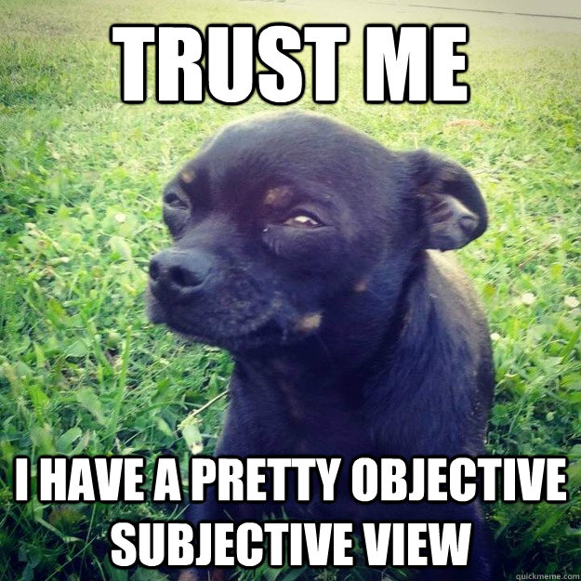
Project Objective
This project aims to analyse the data to determine the cause of customer churn customers who are most likely subject to churn, and what to do to retain the most valuable customer.
- To Predict customer churn.
- Highlighting the main variables, factors influencing customer churn.
- Maximising company profit by retaining customers
- Minimising churn by identifying the reasons of the problem.
- Business Constraints like service quality, offers & discounts.
-Finding out best model & providing Executions.

Slide 6
Dataset Description
-The source dataset is in CSV format.
-Dataset contain 3333 rows and 20 columns.
-There is no missing values in the provided dataset.
-churn is a variable which shows whether a particular customer is churn are not.
Decision Variable - Churn
9.Total eve charge
10.Total night minutes
11.Total night calls
12.Total night charge
13.Total Intl minutes
14.Total Intl calls
15.Total Intl charge
- Numerical Data
1.Number Vmail messages
2.Total day minutes
3.Total day calls
4.Total day charge
5.Total eve minutes
6.Total eve calls
7.Customer service calls
8.Account length
- Categorical Data
1.State
2.International Plan
3.Voicemail Plan
- Nominal Data
1. Area Code

Slide 7
Dataset Description
STATE: There are 51 unique state present
ACCOUNT LENGTH: It is the length that the customer used their account
AREA CODE: There are 3 unique area code present
TOTAL (DAY/EVENING/NIGHT/INTERNATIONAL) (MINUTES/CALLS/CHARGES):
These are total 12 columns, and all are numerical data type. These contain the data of calls, minutes, charges of the customer with respective to the various time of the day and plan.
-
INTERNATIONAL PLAN & VOICEMAIL PLAN:
Both column are described as a categorical feature, yes means plan taken no means plan not taken
NO. OF VOICEMAIL MESSAGES: The number of voicemail make by the voicemail plan taken customer
Customer service calls: It is the number of calls made by the customer to operator service centre
Churn: It is our target dependent variable having boolean data type of true and false

Slide 8
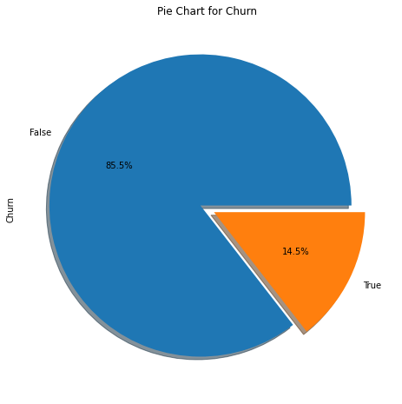
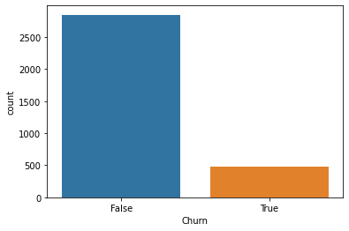
Decision Variable: Churn
Total Users number - 3333
2850 - Non churn (85.5%)
483 - Churn (14.5%)
-Pie Chart shows the percentage of total churned and not churned customer. we can see there is a 14.5% people moving towards churn.
- A count plot shows the number of customer churned and not churned. We can see from 3333 values there is near about 500 values.
.

Slide 9
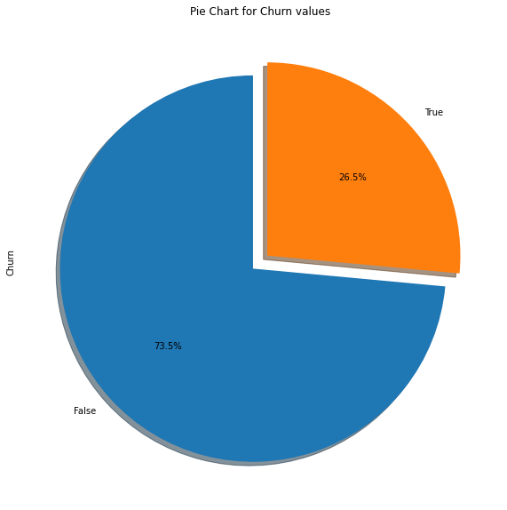
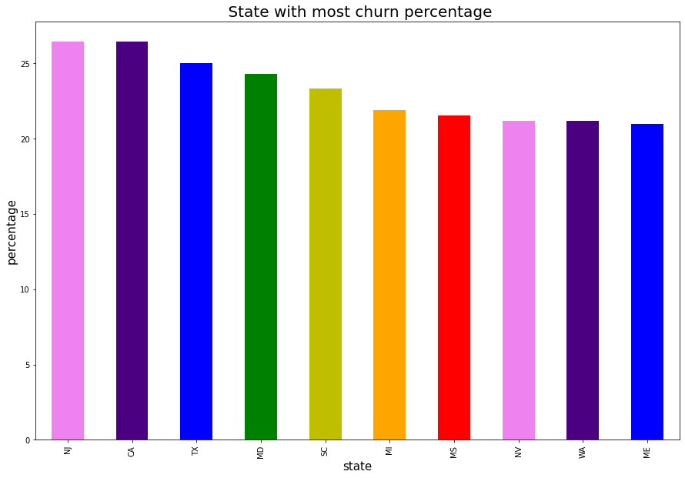
Churn Percentage w.r.to State
.
From Bar Plot we can see top 10 state who are closely moving toward churn
From Pie Chart we can see churn percentage is 26.5%, means within 4 years company will loss all the respective customers.
CA, NJ ,TX , MD ,SC ,MI are the ones who have higher churn rate more than 21.74%

Slide 10
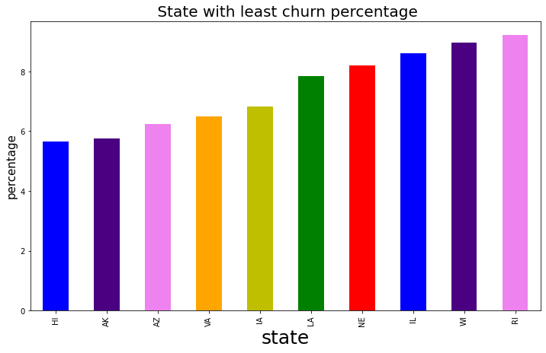
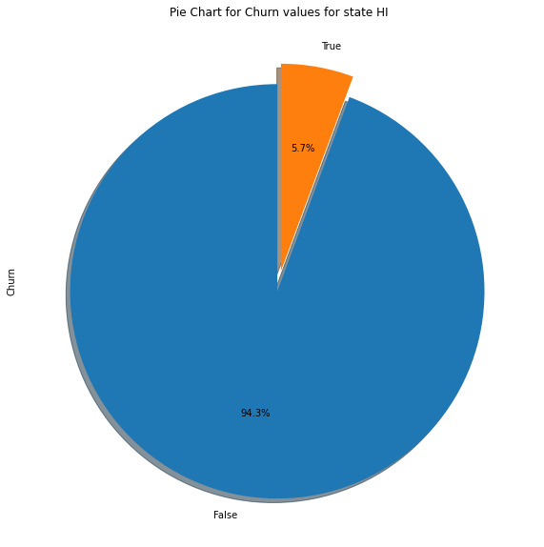
Churn Percentage w.r.to State
.
From Bar Plot we can see Bottom 10 state who are closely moving toward churn
From Pie Chart we can see churn percentage is 5.7%, It is very much less as compared to top 10 states.
HI state is the one who have lower churn rate.

Slide 11
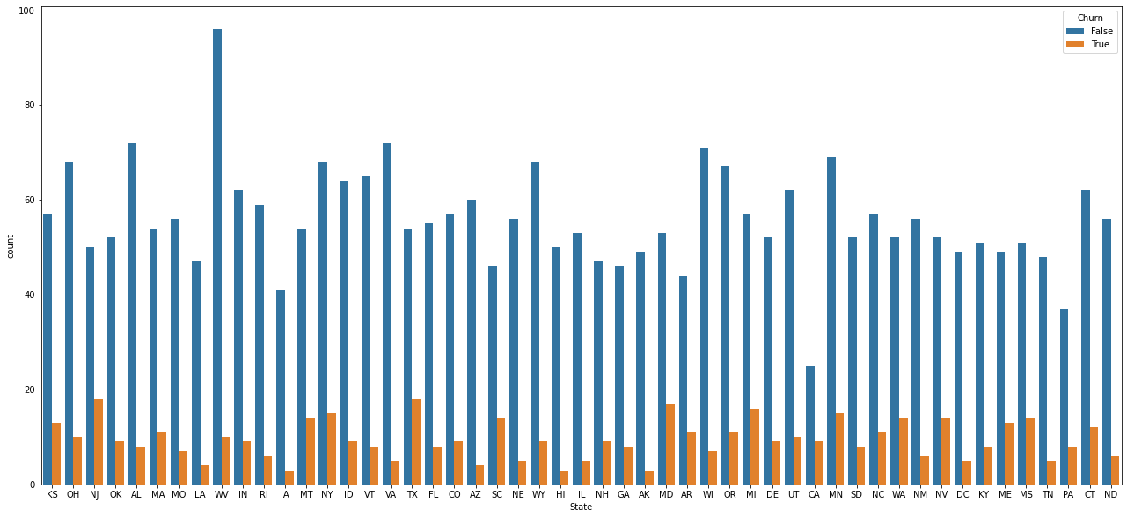
Churn Percentage w.r.to State
.
Above graph shows the state-wise churn describtion.
From We have seen Top 10 and bottom 10 states.
One more factor come into consideration before churn, whether customers calls to customer care or not?

Slide 12
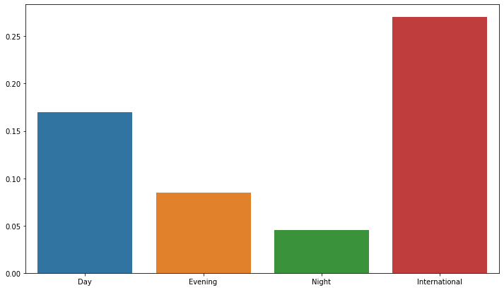
Churn Percentage w.r.to State
From graph we can see International call rates have more impacts than remaining three call rates.
.
Another factor that impact on churn is Rate. If the rates ae high, then the churn will be on higher side. Because customers ready to move towards low charge rate or more offers.

Slide 13
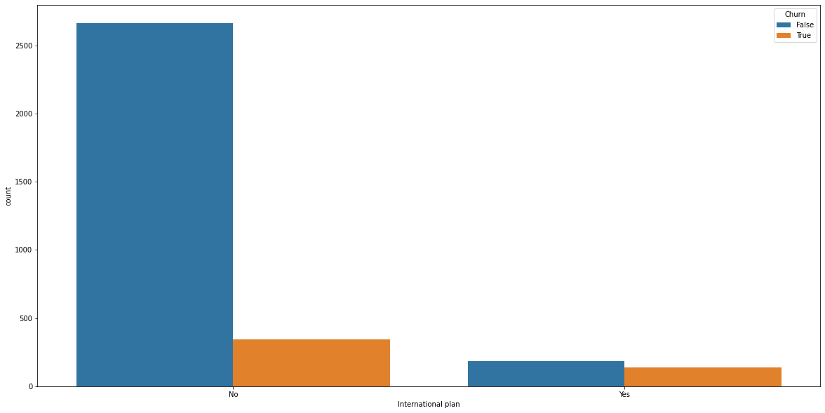
Churn Percentage w.r.to State
Other plan Users - 3010
Intl. plan Users- 323
Chart shows out 323 Intl plan users, 137 users are moving towards churn, which is 42.41% in percentile.
That means there is some cause which effects the churn rate like call price or network issue
.
Graph shows International plans and the customers having international plan who are moving towards churn.

Slide 14
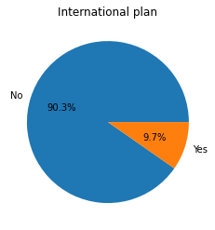
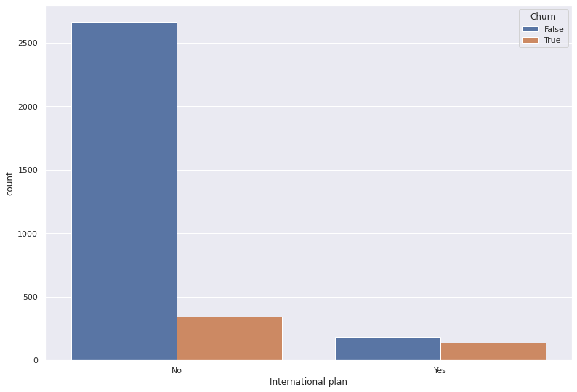
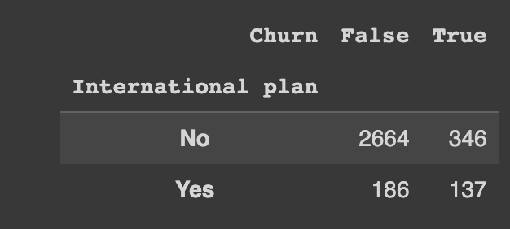
International Plan w.r.to Churn
Other plan Users - 3010
Intl. plan Users- 323
Pie Chart shows the percentage of total customer with and without Intl Plan.
Count plot shows the number of churn and not churn customer using international plan.
.

Slide 15
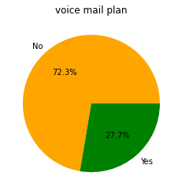
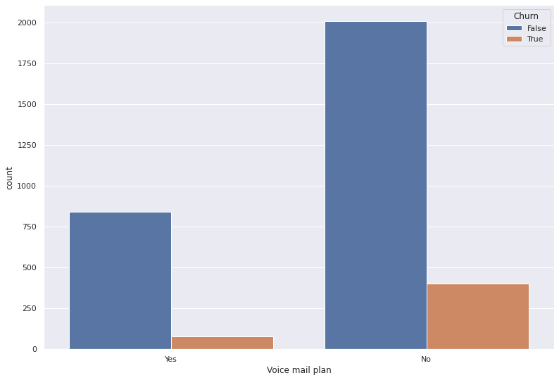
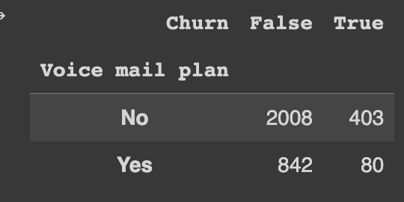
Voice Plan w.r.to Churn
Total User No. - 3333
2411- No IP (72.3%)
922 – IP (27.7%)
Pie Chart shows the percentage of total customer with and without Voice Plan.
Count plot shows the number of churn and not churn customer using Voice mail plan.
.

Slide 16
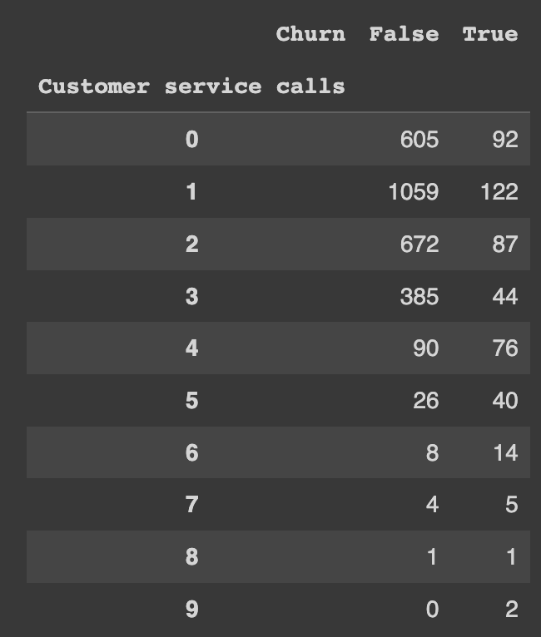
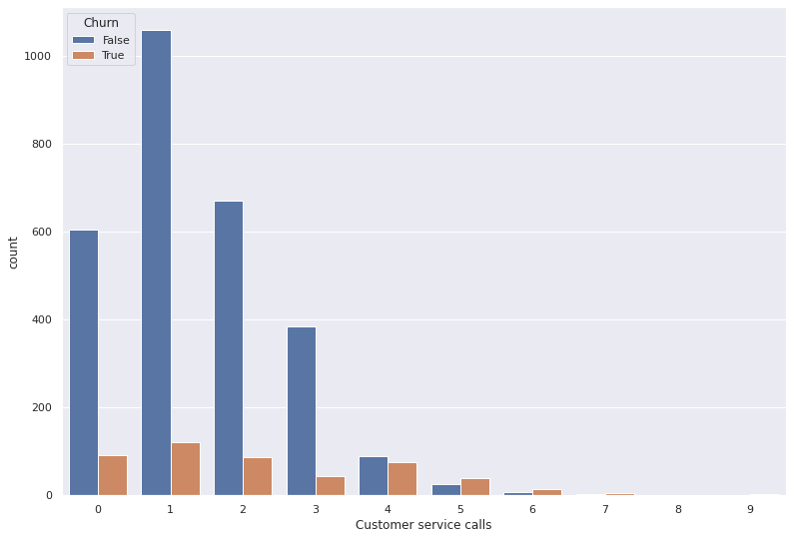
Customer Service Call
Total User No. - 3333
Data Chart shows the No. of customer service calls for churn and not churn users.
Count plot shows the number of churn and not churn customer with service call .
.
Customers who have called more or once also have a high churn rate indicating their issue was not solved in the first attempt. So operator should work to improve the service call

Slide 17
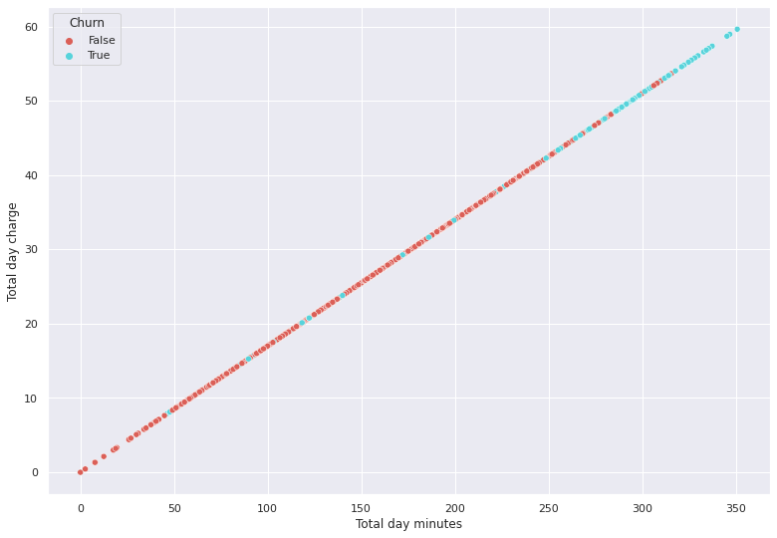
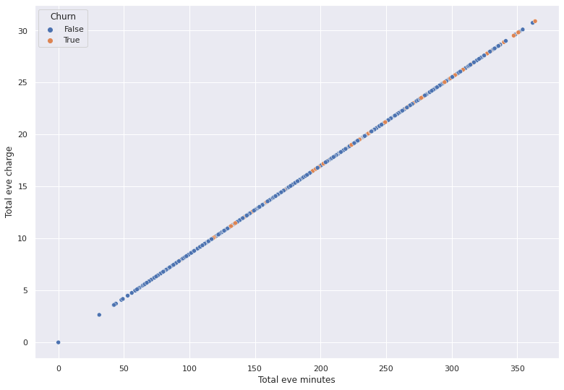
Analyzing Calls
.
We are using the Mean, Median to represent calls with total charge vs total minutes (for day, evening and night calls) using scatter plot with respect to churn and not churn user.

Slide 18
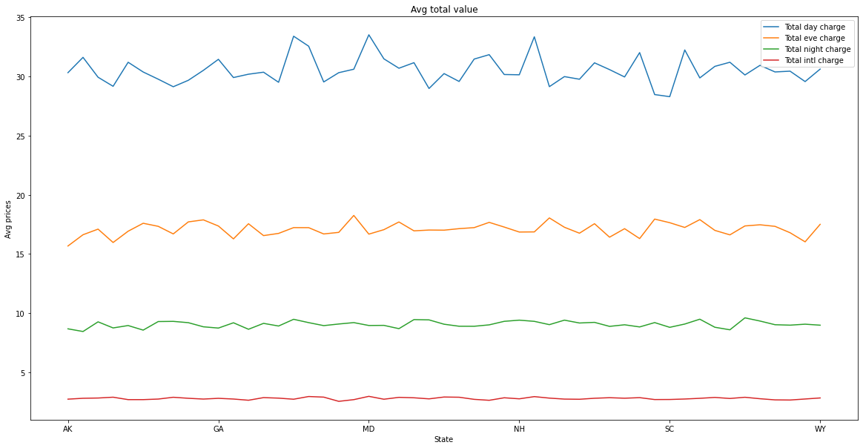
Company Revenue from Customers
Let us see the revenue of company from customers. the graph shows the relation between average prices and states.
Maximum Revenue is generated by customers who use day calls.
.
From Prices we can see International Calls have more rate but revenue they generates is small.

Slide 19
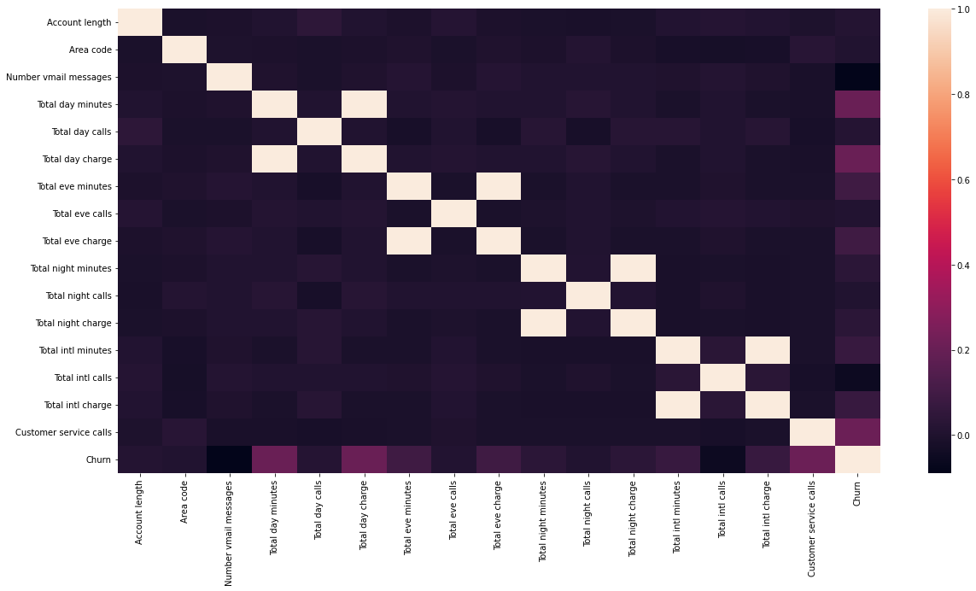
Relation between churn with others columns
From Heat Map we can find direct and indirect co-relation between various factors.
there is not more but some what relation between total day minute and churn, total day charge and churn, customer service call and churn.
.

Slide 20
Conclusion
From the given data and after the EDA and comparison with all the elements we can say that there are some factors which company should take care in consideration.
1. States with high percentage of churn rate approaching towards customer service center. Instead of port request is put by some customers, customer service should approach approach to them.
2. People with international plan who use more international minutes are moving towards churn.
3. Due to high day charges people who use day minutes more ae moving towards churn. As of that we would like to suggest take a fix price for all types of times or lower the charges for day and increase for evening and night.
4. For a telecom company it I necessary to approach towards customers on ground level and within certain period launch new schemes and offers.
5. States where customers churn rate is high, increase advertisement in that area and increase customer service centers.

Slide 21
Recommendations
1. Try to offer better service for churn customers, see how much this impact before and after. Some may use your service better move them to your active customers.
2. take a feedback and suggestions with in period of time and improve it, strive for better communication. .
3. When you are taking the any change in plans of your business, just predict the positive and negative share of that plan. If it is negative prepare the solution before so you can handle easily.
4. Offer Incentives.
5. Lean into your best customers.
6.stay competitive.

Slide 22
THANK YOU…

